Slide 1
LogJam
Guide to parse logs using LogJam web tool.
Confidential

Slide 2
Overview
Introduction.
Basic Architecture.
Search.
Log Analysis.
Confidential

Slide 3


I. Introduction
LogJam was originally created to support the STB watchdog effort. This was later expanded to include all crashes and deadlock from siege, dvrplayer and ca_manager. Box will automatically send back a tarball containing logs, core file and other information when it detects watchdog reboot at bootup.
Watchdog:
There are some possible causes for watchdog reboot:
  Kernel oops
  Running out of C memory due to memory leak from other processes.
  Process crash.
  Deadlock
Confidential

Slide 4
II. Basic Architecture
LogJam consists of 3 parts:
  Bash scripts.
  Database.
  Web Front End.
Confidential

Slide 5
II. Basic Architecture (cont.)
Bash scripts: Processing log tarball through bash scripts
  A bash script is called to process the tarball for known issues such as kernel oops and memory leak.
  It uses a cross-platform gdb to retrieve the backtrace of the core file from production image.
  Data is inserted to the database through Perl script.
  Logs are pulled from log server to LogJam.
  Getter log is processed on demand through LogJam's search page.
Database: save all known warnings through perl scripts.
Confidential

Slide 6
II. Basic Architecture (cont.)
Web Front End
  Web front end is used to query the database and present the data through php script.
  Write Report (logs written to USB) decryption is added recently on LogJam through Tarball Upload search field.
  Website supports hidden Wiki markups. This allows user to copy and paste between LogJam and Jira while retaining the formatting.
  Web front end URL: http://172.31.59.92/logjam_search.php
Confidential

Slide 7
III. Search
By File Name.
Process Getter
Tarball Upload.
By RID.
Confidential

Slide 8

III. Search
By File Name
“By File Name” is used to parse specified format log files such as “YYYYMMDD-XXXX” that are reported by DBS Talk.
  Go to LogJam's search page at http://172.31.59.92/logjam_search.php
  Select menu “Search” -> “Simple Search”.
  Enter the Report number as “Log Key” into “By File Name” field.
    Example: 20110423-254B.
  Click on “Submit” and wait for it to finish.
Confidential

Slide 9
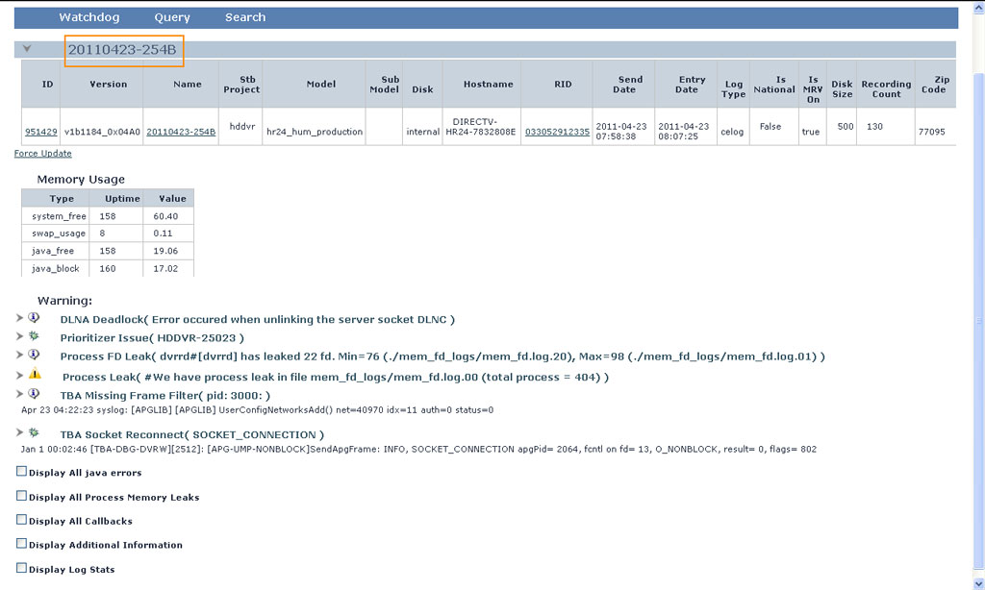
III. Search (cont.)
By File Name (cont.)
This is result of log id 20110423-254B.
Confidential

Slide 10

III. Search (cont.)
Process Getter
“Process Getter” is used to identify known issues from getter log on the ftp folder.
  Go to LogJam's search page.
  Copy and paste the full getter path including the FTP IP address into “Process Getter” field.
    Example: ftp://10.23.161.95/getterLogs/yenhd/STBLOG.yenhd.140418.005525.els-e77421.192.168.46.19.pac.hr44.v1b2145_0x0861.tgz
  Click on “Force Update” and wait until the next page displays.
Confidential
Notes:
Access Jira ticket HDGHMC-55007 to copy log file URL.

Slide 11
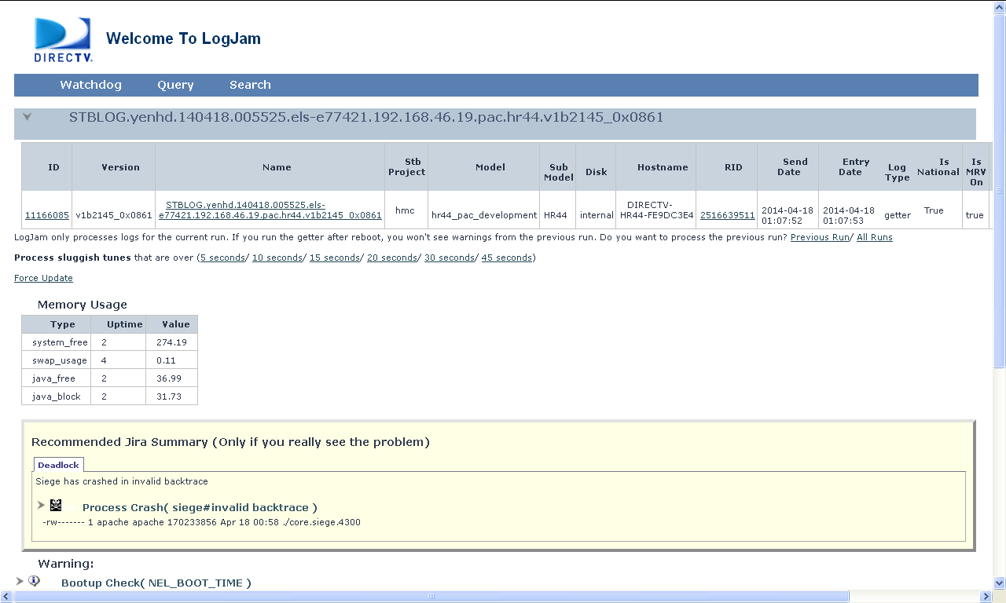
III. Search (cont.)
Process Getter (cont.)
This is result of getter log on ftp folder.
Confidential

Slide 12

III. Search (cont.)
Tarball Upload
“Tarball Upload” is used to identify known issues that the log file is located under local computer. The log file size is limited to 20MB.
  Go to LogJam's search page at http://172.31.59.92/logjam_search.php
  Click on the “Browse” under “Tarball Upload” on LogJam.
  Select the encrypted log file from local computer to upload.
  Click on “Upload File” and wait until the next page displays.
Confidential

Slide 13
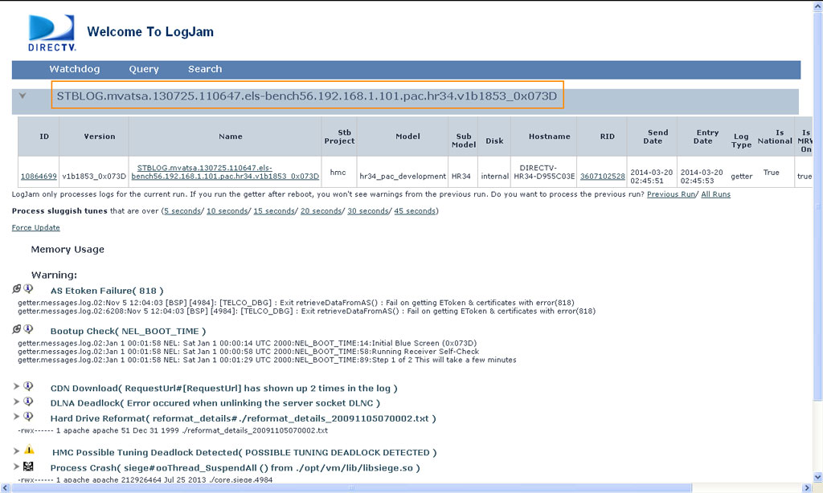
III. Search (cont.)
Tarball Upload (cont.)
This is result of parsing log file using Tarball Upload.
Confidential

Slide 14

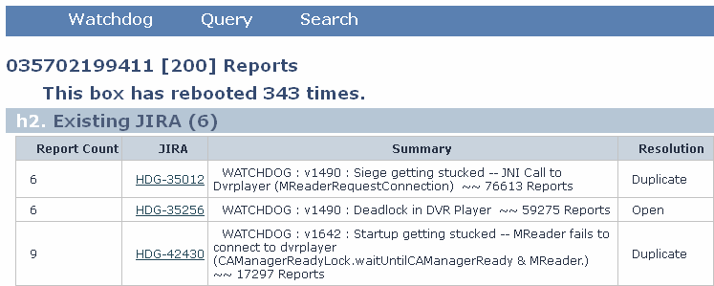
III. Search (cont.)
By RID
“By RID” is used to list all issues that was reported from a box using STB’s RID.
  Go to LogJam's search page at http://172.31.59.92/logjam_search.php
  Enter a RID into “By RID” field.
  Click on “Submit” and wait until the next page displays.
Confidential

Slide 15
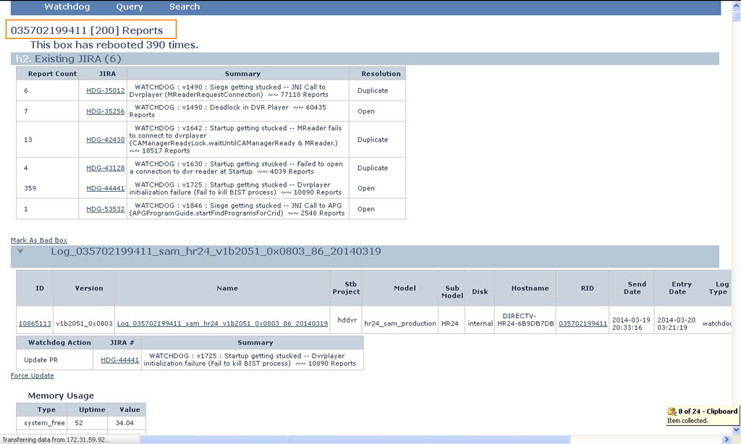
III. Search (cont.)
By RID (cont.)
This is search result of STB’s RID.
Confidential

Slide 16
IV. Log Analysis
How to check boot command?
How to check installed plug-ins?
Common log file issues.
  Frozen with core files
  Common issues.
Confidential

Slide 17
IV. Log Analysis
How to check boot command?
BOOT ARGUMENTS are located in a config file that gets built for each platform and build and stored in the same CVS directory where the squashfs image is located.
For example, the HR24-200 config file for build v1811 has these boot arguments:
boot -lz -elf flash0.kernel: "root=/dev/mtdblock2 rootfstype=squashfs resmem=75m@155m(cdi) resmem=26m@230m(grmem)"
Confidential

Slide 18
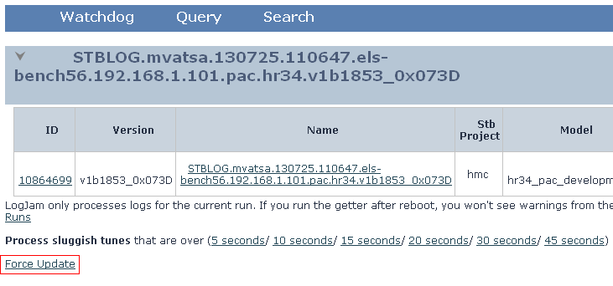
IV. Log Analysis (cont.)
How to check boot command? (cont.)
Wrong boot command makes the STB became unstable.
To check boot arguments in log file using LogJam, select “Force Update" link under the log id after searching.
Confidential

Slide 19
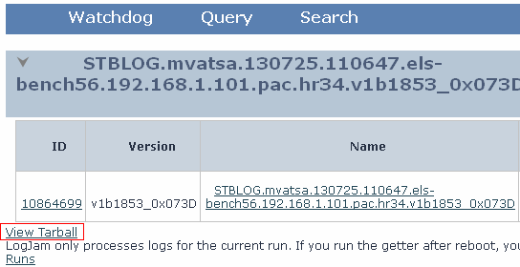
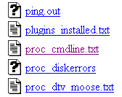
IV. Log Analysis (cont.)
How to check boot command? (cont.)
“View Tarball” link will display under the log id, click on it. Select “proc_cmdline.txt” to check boot command.
For example: Jira ticket HDGHMC-13976 is invalid due to wrong boot command.
Confidential

Slide 20
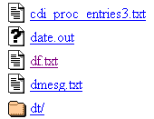
IV. Log Analysis (cont.)
How to check installed plug-ins?
In "View Tarball" link, select "df.txt“ or “install_plugin.log” to check installed plug-ins.
For example: Jira ticket HDG-32196 is invalid due to missing iTV plug-in.
Confidential

Slide 21
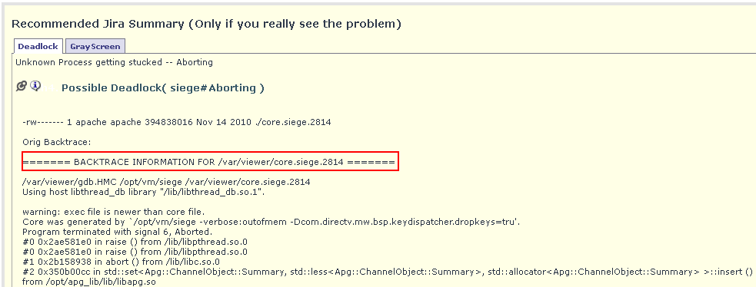
IV. Log Analysis (cont.)
Common log file issues.
Frozen with core files.
  Let’s examine HDGHMC-942.
Confidential

Slide 22
IV. Log Analysis (cont.)
Common log file issues. (cont.)
Common issues.
  The root cause in dtdumpstack.
  The root cause is the Exception.
  Deadlock.
  Memory leak.
  APGFatal.
Confidential

Slide 23

Thank you
Confidential

